Slide 1
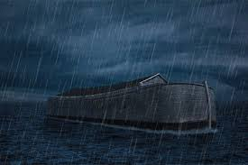
PREDICTION OF FLOODS USING
ENVIRONMENTAL ANALYSIS
TEAM MEMBERS: APEKSHA B
CHINMAYA G R
KRUTHIKA C S
MADHUMATI J B
VEENA M R

Slide 2
INTRODUCTION AND OVERVIEW:
Floods are among the most destructive natural disasters, which are highly complex to model. The research on the advancement of flood prediction models contributed to risk reduction, policy suggestion, minimization of the loss of human life, and reduction of the property damage associated with floods.
To mimic the complex mathematical expressions of physical processes of floods, during the past two decades, machine learning (ML) methods contributed highly in the advancement of prediction systems providing better performance and cost-effective solutions.

Slide 3
The applications in ﬂood prediction can be classiﬁed according to ﬂood resource variables, i.e., water level, river ﬂood, soil moisture, rainfall–discharge, precipitation, river inﬂow, peak ﬂow, rainfall–runoff, ﬂash ﬂood, rainfall, streamﬂow, seasonal stream ﬂow, ﬂood peak discharge, urban ﬂood, plain ﬂood, groundwater level, rainfall stage, ﬂood frequency analysis, ﬂood quantiles, surge level, extreme ﬂow, storm surge, typhoon rainfall, and daily ﬂows.
A combination of these ﬂood resource variables and ML methods was used to implement the complete list of search queries. The ML methods for ﬂood prediction may vary signiﬁcantly according to the application, dataset, and prediction type.

Slide 4
This survey identiﬁes the state of the art of ML methods for ﬂood prediction where peer-reviewed articles in top-level subject ﬁelds are reviewed.
Multiple classification algorithms like Linear regression, Random Forest, Decision tree algorithm were compared and evaluated based on their accuracy, and obtained equal accuracy for all the three algorithms i.e., 1.0
Chose decision tree to predict the success of application

Slide 5
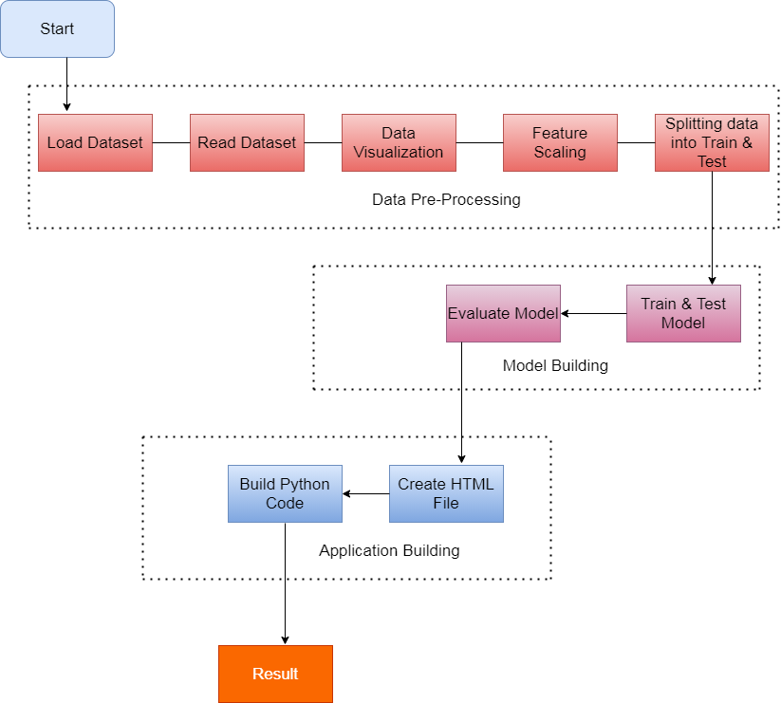
FLOW CHART

Slide 6
SOFTWARE DESIGN:
Jupyter Notebook Environment
Spyder Ide
Machine learning algorithms.
Python (pandas, numpy, matplotlib, seaborn, sklearn)
HTML
Flask

Slide 7
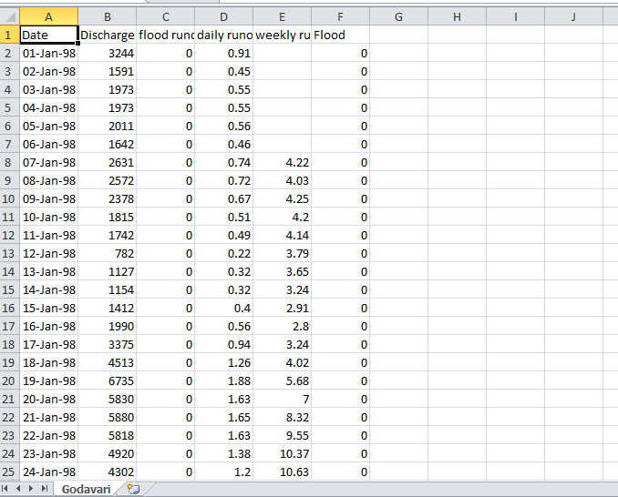
A SLOPPY VIEW OF THE EXPERIMENT
Dataset used for the experiment:

Slide 8
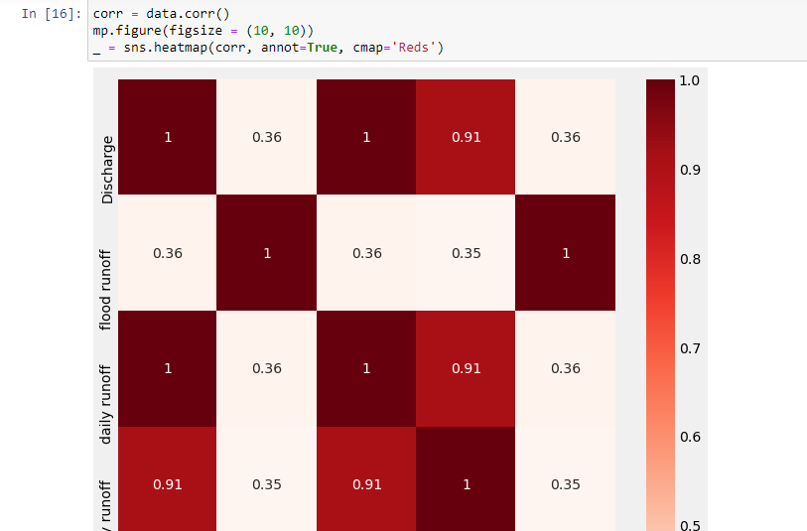
HEAT MAP:

Slide 9
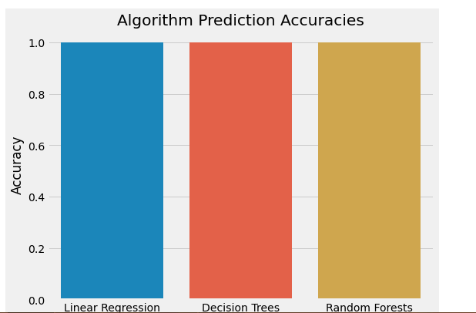
Comparision of accuracies between linear, decision tree and random forest regression:
Obtained equal accuracy in all the 3 algorithms i.e., linear regression, decision tree and random forest algorithms are resulted 100% accuracy.
Algorithm | Accuracy
Linear regression | 100%
Decision tree | 100%
Random forest | 100%

Slide 10
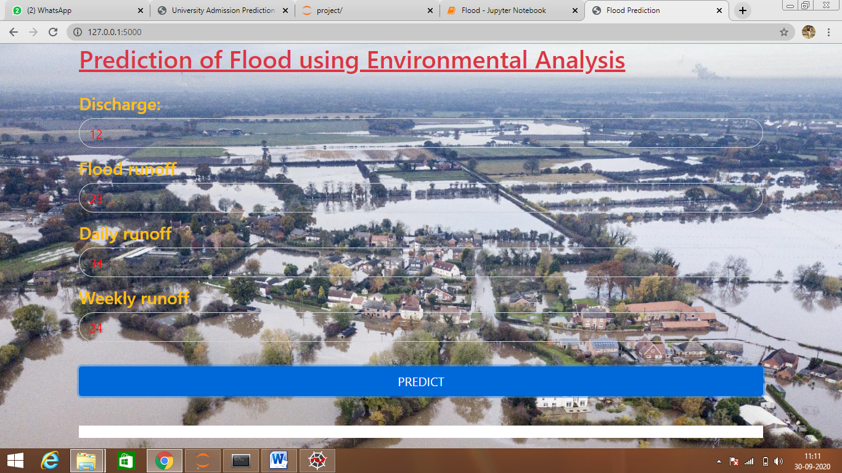
RESULT:

Slide 11
CONCLUSION:
Among the articles identiﬁed, through search queries using the search strategy, those including the performance evaluation and comparison of ML methods were given priority to be included in the review to identify the ML methods that perform better in particular applications.
The priority is given for decision tree. Selected the method by familiarity as we got equal accuracy for all the three.

Slide 12

THANK
Y U

